Slide 1

Byju’s Learning Analytics Dashboard
Data Cleaning, KPI Design & Business Insights from Student, Fee and Engagement Data
Presented by
SATHYAMOORTHY M
Advanced Excel Project

Slide 2
AGENDA
What This Presentation Covers
01
Project Overview
02
Data Cleaning Framework
Scope, data source and objectives of the analysis
Standardising, flagging and validating raw records
03
Cleaning & KPI Formulas
04
Pivot Table Analysis
Excel functions used to build a reliable dataset
Fees, enrolment and performance cut by course & state
05
Interactive Dashboard
06
Key Insights & Recommendations
Consolidated view for leadership decision-making
What the numbers mean for the business
BYJU'S | Learning Analytics Dashboard
2

Slide 3
PROJECT OVERVIEW
From Raw Records to Business-Ready Insight
The workbook tracks 606 learners enrolled across eight BYJU'S course lines. Raw enrolment, fee and engagement records were cleaned, validated and flagged for quality before being summarised into pivot tables and a leadership dashboard.
606
Total Students
₹ 4.56 Cr
Fees Collected
Workflow
Raw Data
→
Cleaning & Flags
→
Formulas & KPIs
→
Pivot Tables
→
Dashboard
₹ 1.81 Cr
Fee Outstanding
26,100.9
Study Hours Logged
BYJU'S | Learning Analytics Dashboard
3

Slide 4
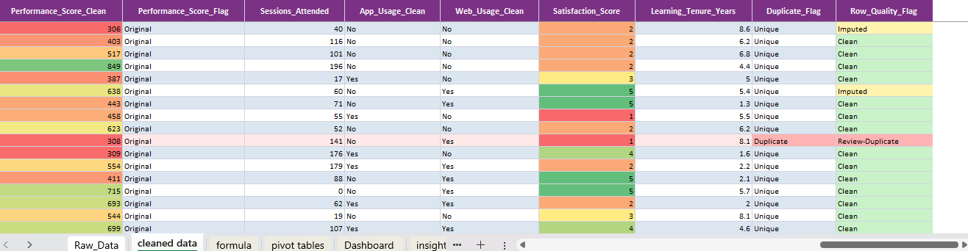
DATA CLEANING
A Rule-Based Data Quality Framework
Every record carries a clean/original flag and a duplicate check, rolled up into a single Row Quality Flag — so analysts know at a glance which rows are trustworthy, imputed, or need review.
Imputed — missing value replaced with a valid estimate
Clean — passes all validation rules
Review-Duplicate — duplicate record flagged for review
BYJU'S | Learning Analytics Dashboard
4

Slide 5
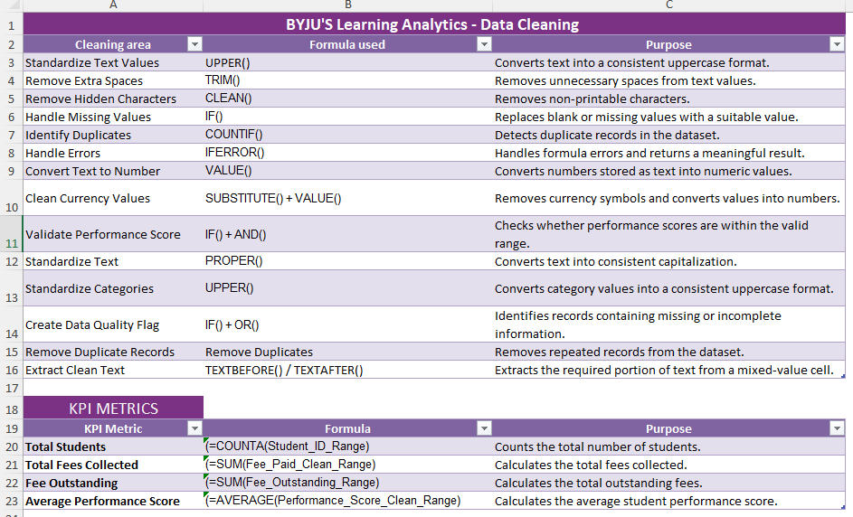
METHOD
Excel Formulas Behind the Clean Dataset
Why it matters
UPPER(), TRIM() and CLEAN() standardise text and strip hidden characters
IFERROR() and IF()+AND() catch bad values and validate performance scores
COUNTIF() identifies duplicate student records automatically
SUBSTITUTE()+VALUE() converts currency text into usable numbers
TEXTBEFORE()/TEXTAFTER() extract clean text from mixed-value cells
BYJU'S | Learning Analytics Dashboard
5

Slide 6
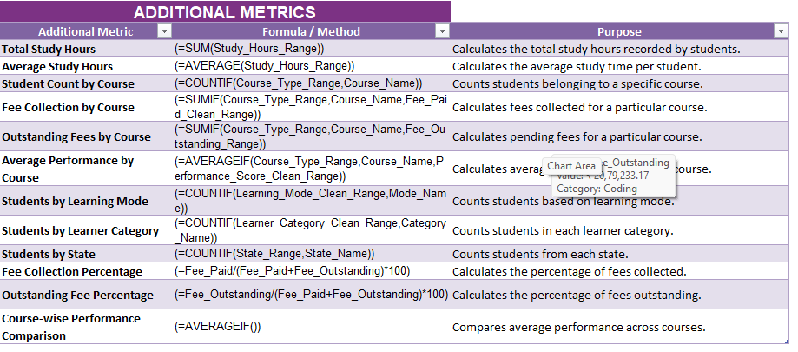
METHOD
Formulas Powering the KPI Metrics
Once the data was clean, aggregate formulas turned individual records into the KPI metrics and course-level breakdowns shown on the dashboard.
BYJU'S | Learning Analytics Dashboard
6

Slide 7
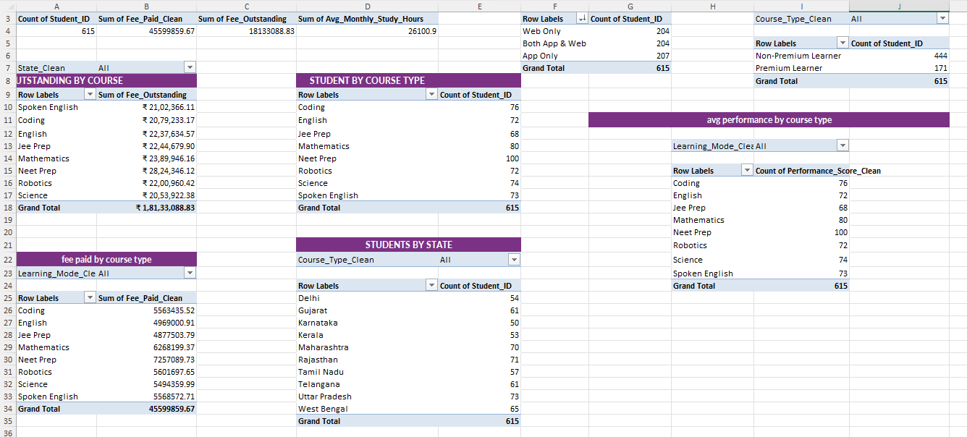
ANALYSIS
Pivot Tables: Course, State & Learning-Mode Cuts
BYJU'S | Learning Analytics Dashboard
7

Slide 8
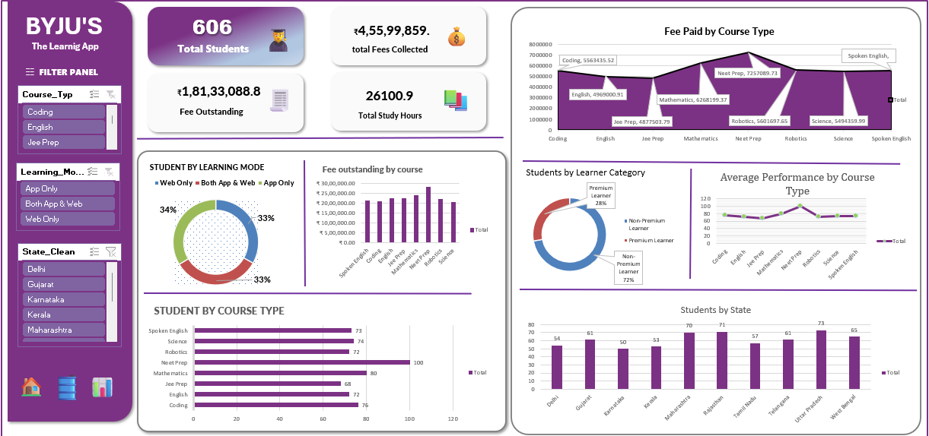
THE DASHBOARD
A Single View for Leadership Decisions

Slide 9
INSIGHTS
What the Data Tells the Business
1
2
3
Fee Outstanding
Course Demand
Learner Mix
₹1.81 Cr remains outstanding against ₹4.56 Cr collected — a 28% shortfall needing active follow-up.
NEET Prep leads enrolment (100 students) and fee contribution (≈₹72.5 L), and also shows the highest average performance.
Non-Premium learners make up 72% of the base — a strong pool for premium upgrade campaigns.
4
5
6
Engagement Balance
Geographic Reach
Study Engagement
Web-only, app-only and blended usage are near-evenly split (33–34%) across the learner base.
Uttar Pradesh (73) and Maharashtra (70) are the strongest states; representation is broad across 10 states.
26,100.9 total study hours logged, reflecting healthy day-to-day platform engagement.
BYJU'S | Learning Analytics Dashboard
9

Slide 10
RECOMMENDATIONS
Turning Insight Into Action
Prioritise fee recovery
Target structured follow-ups on the ₹1.81 Cr outstanding, starting with the highest-value accounts.
1
Scale NEET Prep capacity
Invest in tutors and content for NEET Prep given its lead in enrolment, fees and performance.
2
Convert non-premium learners
Design upgrade offers for the 72% non-premium segment to grow premium revenue share.
3
Sustain omni-channel access
Keep investing across web and app equally, since usage is evenly balanced across both.
4
BYJU'S | Learning Analytics Dashboard
10

Slide 11
Thank You
Questions & Discussion
SATHYAMOORTHY M
Advanced Excel | BYJU'S Learning Analytics Project

